Slide 1
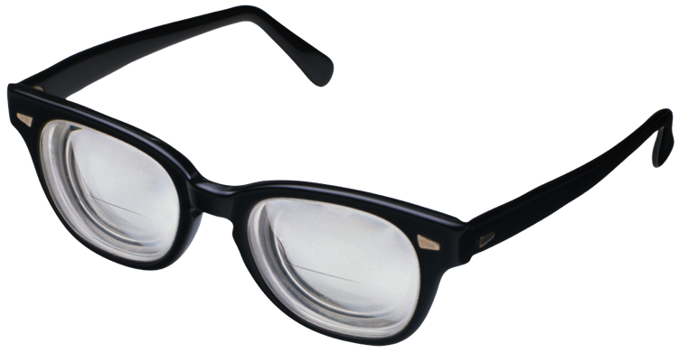
VISUAL IMPAIRMENTS
Chris, Kaila, Lauren

Slide 2
Visually Impaired Learners
IDEA Definition
“an impairment in vision that, even with correction, adversely affects a child’s educational performance. The term includes both partial sight and blindness.’’
A Medical/Legal Definition
Low Vision
20/70 to 20/200
Blind
20/200 or worse
An Educational Definition
Visual Readers
Braille Readers
Lauren Dermody
Sources: Hallahan, http://nichcy.org “Visual Impairments” fact sheet

Slide 3
Prevalence
25,670 visually impaired learners
0.05% of students
Lauren Dermody
Sources: Hallahan, http://nichcy.org “Visual Impairments” fact sheet

Slide 4
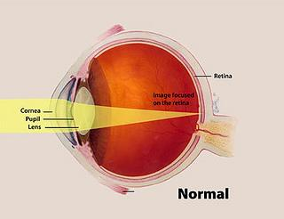
The Eye
Lauren Dermody
Sources: National Eye Institute

Slide 5
Causes of Visual Impairment
Refractive Errors
Myopia, hyperopia, astigmatism
Retinal pathologies
Retinopathy of prematurity
Retinitis pigmentosa
Optic Nerve pathologies
Optic nerve hypoplasia
Cortical visual Impairments
Muscular pathologies
Strabismus
Nystagmus
Lauren Dermody
Sources: National Eye Institute
http://nichcy.org “Visual Impairments” fact sheet

Slide 6
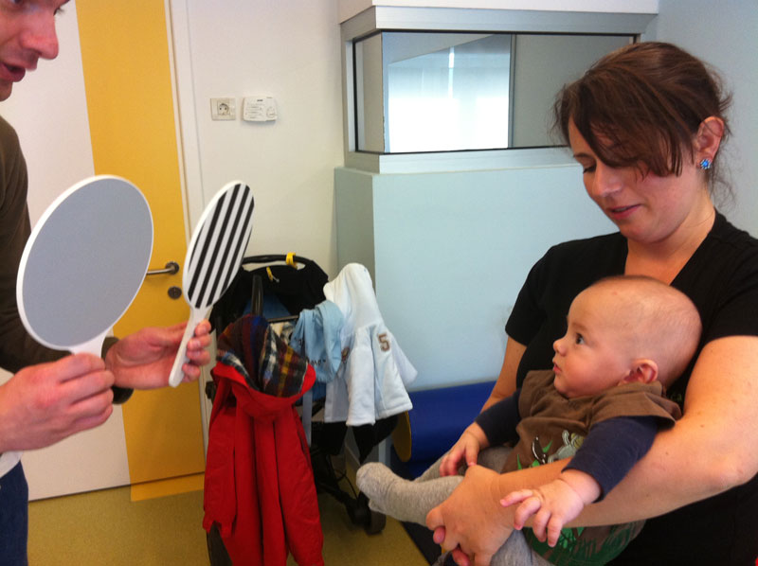
Assessment: Milestones & Warning Signs
V.I. children may differ from “the norm”
Warning signs at 3 months:
Won’t or can't grasp objects
Can't focus on moving objects
Doesn't smile
Ignores new faces
Especially upset by unfamiliar people or surroundings
Pupils that are unequal in size or that appear white
Warning signs at 6 months:
Eyes that don’t move together when following an object or a face
holding toys very close to the face
Repeated shutting or covering of one eye
Eyes that bulge, dance, or bounce in rapid rhythmic movements
Frequent squinting, blinking, eye-rubbing, or face crunching
Crossed eyes, eyes that turn out or in, eyes that flutter from side to side or up and down
Kaila Sanford
Notes:
Slide 1: Assessment
With older children and adults, basic vision assessment is easy. I know I remember getting my eyes checked every year at my annual check-ups.
But what about for infants and pre-verbal/pre-literate children?
The first thing that you look for are the developmental milestones.
It’s important to note that each child is different and moves at his or her own speed, but there are general guidelines about what a typical baby should be able to do at each age.
Babies with vision loss also seem to follow a different developmental sequence. There are some skills that some of them acquire sooner than children who are not visually impaired. They often say their first word, or create two-word sentences (subject + verb) earlier than typical children, and some children also develop higher language skills, such as remembering past events or singing a song from memory, sooner.
If you think about it, it makes sense that when you tend to rely on information from your senses other than vision, you would develop the skills that rely on that input more quickly. This doesn't mean that babies with vision loss are more advanced than typically developing children, but it does mean that they experience the world differently.
For example, a normally developing child will be able to see things 8-12 inches away from their face in their first month. Black and white patterns especially catch their eye.
You can tell this early if a baby is completely blind because they will not react to visual stimuli, even bright lights in their eyes.
But there’s more diversity of visual impairment and most people with visual impairment don’t have 100% vision loss.
By 3 months, a baby’s hand-eye coordination is improving. Babies begin tracking objects that interest them and focusing intently on faces. At this stage babies are already able to recognize their parent from across the room!
If an infant can only sometimes track objects, especially if its only able to under certain lighting conditions, you know that there is either a physical issue or neurological issue hindering their vision.
Luckily, new parents tend to spend a lot of time looking for reactions from their newborns, so catching dramatic visual impairments often happens at a very early age.
Point out warning signs
Already at this age, you can call an early interventionist to have some assessments done to determine what problems might be causing these issues
Remember that an IFSP (Individual family service plan) is available for children under 3. After age 3 you get an IEP.

Slide 7
Appropriate Assessments for:
Infants and Toddlers
Functional Vision Assessment (FVA)
How the child is using his or her vision
Near tasks
Intermediate tasks
Distance tasks
Potential Recommendations following FVA
Changes to the home and school environments
Specific materials that may assist the child
Instructional strategies
Referrals for services from other professionals
Kaila Sanford
Notes:
Photo: http://store.guidedogs.com/images/Onesie_web.jpg
Slide 2: Appropriate Assessments for…
Functional Vision Assessment –
The functional vision assessment is the cornerstone of the assessments done by a teacher of students with visual impairments if a toddler has useful vision. The functional vision assessment is done to find out how a child is using his or her vision for near tasks (closer than 16 inches), intermediate tasks (16 inches to 3 feet) and distance tasks (greater than 3 feet).
It combines formal tests, such as visual acuity (distance tests), with informal activities that the teacher of students with visual impairments designs so that he or she can observe the child using his or her vision.
For example, a child may be asked to match toys according to their color to indicate when he or she can see an object held to his left or right side. Based on the information gathered through such activities the teacher will make recommendations about ways to help the child learn to use her vision more effectively. These recommendations may include

Slide 8
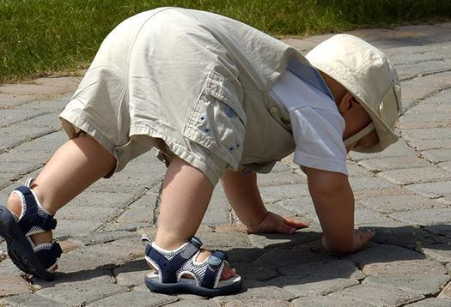
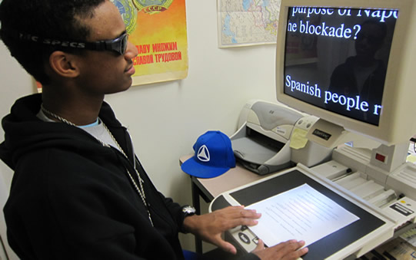
Appropriate Assessments for... (cont)
Preschoolers and school-age children
Learning Media Assessment
How the child is using all of his or her senses
determines the primary way in which the child gathers information and the literacy tools and medium appropriate for his or her instruction
Kaila Sanford
Notes:
Images:
1. http://www.afb.org/image.ashx?ImageID=6156
2. http://www.foothillselpa.org/wp-content/uploads/2011/02/boy-computer.jpg
Slide 3: Appropriate assessments cont
Learning Media Assessment - A learning media assessment is not routinely done until children are in preschool; however, an early interventionist may want to do this assessment before the child approaches his or her third birthday if it is difficult to determine whether the child is more of a visual learner or a tactile learner (one who relies on touch).
The learning media assessment involves observing how the child uses his or her senses (vision, touch, and hearing) to determine the way in which he or she takes in most of his or her information.
A teacher of students with visual impairments will observe the child in his or her daily activities, such as playing a game, walking outdoors, or looking at a book with you. Based on this information, the teacher can make recommendations on the best ways for the baby to learn—for example, whether preliteracy activities you do should be geared more toward print reading or braille.
And now Chris will tell you a bit about curriculum planning for students with visual impairments:
BREAK FOR CHRIS’ SLIDES

Slide 9
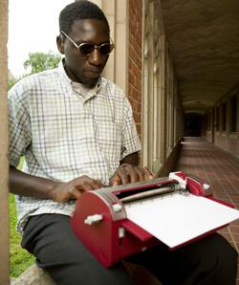
The IEP
Special Factors for IEP of Visually Impaired Students:
Braille
Assistive Technology
Chris
Notes:
Image:
http://www.perkinsinternational.org/sites/international.perkinsdev1.org/files/next-generation.jpg

Slide 10
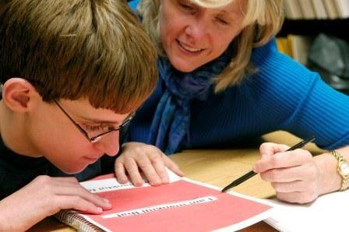
Service Delivery Models / Placement
The Itinerant Model
The Resource Room Model
The Consultation Model
Chris
Notes:
Image:
http://media-cache-ak0.pinimg.com/736x/bd/db/0d/bddb0d55451c410b73ddca9950045c82.jpg

Slide 11
IEP Goals
Write S.M.A.R.T. goals - Specific, Measurable, Achievable, Realistic/Relevant and Timely
Examples
Sensory Efficiency Skills
Goal:
The student will use tactual skills to explore real objects, real shapes and two dimensional shapes/symbols with ___% accuracy.
Objectives:
Tactually discriminate common objects
Identifies shapes
Chris

Slide 12
IEP Goals Continued
Example 2
Orientation and Mobility
Goal:
The student will develop, improve or maintain skills in long cane techniques, ___% of the time.
Objectives:
Name the parts of the cane
Use the appropriate grip for the diagonal technique
Chris

Slide 13
IEP Goals Continued
Example 3
Social Skills
Goal:
The student will demonstrate positive and accurate self-awareness in __ of __ sessions.
Objectives:
indicate awareness of own visual abilities and limitations
Chris

Slide 14
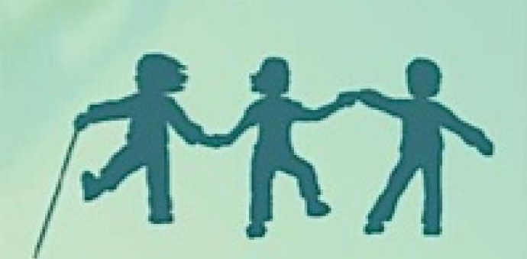
The Expanded Core Curriculum
Your IEP Goals should address the areas of the Expanded Core Curriculum
What is the Expanded Core Curriculum?
Chris
Notes:
http://www.wonderbaby.org/sites/wonderbaby2.perkinsdev1.org/files/styles/full_width_display/public/making-it-work.jpg?itok=CXdpGiWP

Slide 15
The Expanded Core Curriculum
The Expanded Core Curriculum (ECC) is the collection of nine areas of concepts & skills that require specialized instruction needed by students with vision loss in order to be successful in school & in post-graduate pursuits.
Chris

Slide 16
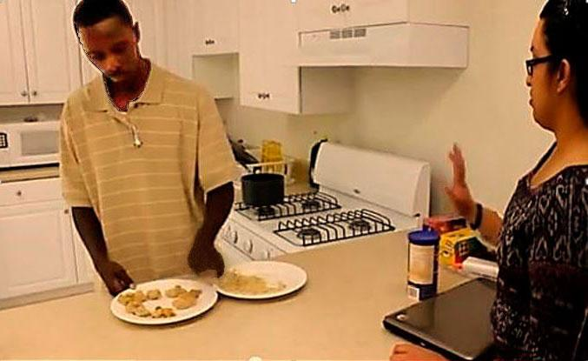
Components of the Expanded Core Curriculum
Compensatory or Functional Academic Skills
Orientation and Mobility
Social Interaction Skills
Independent Living Skills
Recreation and Leisure Skills
Career Education
Technology
Sensory Efficiency Skills
Self-Determination
Chris
Notes:
Image: http://blindnesssupport.com/images/living.jpg

Slide 17
The Itinerant Model and the TVI
Who are the TVI’s?
Chris

Slide 18
Accommodations and Modifications in Your IEP
Accommodations May Include:
Changes made in the way materials are presented
Changes in the way students demonstrate learning
Changes in setting
Changes in the setting environment
Modifications…
Lower the learning expectations
Should only be used if it is the only way for the student to be successful
Accommodations for ACT, PSAT, SAT and AP programs are overseen by Services for Students With Disabilities (SSD), part of a nonprofit organization sponsoring pre-college and college admissions tests.
Chris

Slide 19
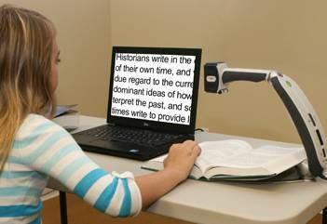
Assistive Technology in the IEP
For Daily Living:
commercially available braille tags for clothing
high contrast utensils and dishes
For Listening:
hearing aids
sound cancelling headphones
classroom amplification
For Reading
braille books
books on tape, CD, or MP3
electronic magnifier
...and many more
Chris
Notes:
Image: http://www.visual-techconnection.com/tranfmr5.jpg

Slide 20
Social Integration Challenges
Visual cues in Communication
Simulation
Communication Tips:
Identify yourself
Address person by name
Show active listening
Speak normally and clearly
Excuse yourself when you leave a room
Kaila Sanford
Notes:
Photo: http://images.thezooom.com/image.php?src=2012/11/Obama-Shrug-Mouth.jpg
Visionaware.org has resources and tips for communication with visually impaired people
Slide 4: Social Integration
Simulation:
Alright, I’m going to walk you through a very short simulation here.
If you wouldn’t mind taking a break from your note-taking to close your eyes for a moment.
Pretend that you are trying a new food in front of the chef and you want to signify that it tastes very bitter and a little bit yucky to your friend without saying anything out loud.
Ok, good.
Now pretend that someone has asked you and your classmate-partner a question and you don’t know the answer. You’re baffled and a little bit embarrassed. What would you do with your body to signify this?
Ok, good.
Last one: Pretend that you are in a class where there is a famous and well-respected guest speaker. They begin going off on ANOTHER tangent about something completely irrelevant. You’re frustrated but can’t be rude. What would be the silent face that you’d make to your best friend across the room?
Great! Now open your eyes.
Who can tell me why I had you do that?
Did you hear or feel anything from those facial expressions/gestures?
Imagine now that your friend was visually impaired and couldn’t see your facial expression very well. Do you think they would have gotten the information that you were portraying non-verbally?
This simulation is just a small taste of why it is important to communicate slightly differently with people who are visually impaired.
It’s actually very easy to conduct yourself in a way that is comprehensible to people who can’t receive your nonverbal cues.
If you are a teacher and you want to use your body to help students “see” your point, just narrate your body movements
(DEMONSTRATE)
Here are some general guidelines for how to be accommodating to visually impaired people (children and adults) who may be in your community:
When you enter a room, announce your presence and if a visually impaired person enters a room you're already in, let him or her know you're there.
Identify yourself by name when you start talking. For example, "Hi, Jane, it's Kaila."
Speak clearly and directly, and look at the person when addressing him or her. (directional voice)
Use natural conversational tone and speed. Unless the person has a hearing impairment there's no need to raise your voice or speak slowly.
Address the person by name, so he or she will immediately know that you're talking to him or her rather than someone who happens to be nearby. (If you don't know the person's name, give a light touch on the arm to let the person know you are addressing him or her.)
Be an active listener. Give the person opportunities to talk. Respond with questions and comments to keep the conversation going. Remember, a person experiencing vision loss can't necessarily see the look of interest on your face or nodding to show comprehension, so take care to vocalize your interest ("Yes … I see … I understand," etc.).
Say when you're leaving a room and where you're going, if appropriate. For example, say, "I'm going to the Computer Lab to get the page I just printed for you."
Indicate the end of a conversation so that the person you've been talking to left talking to an empty room. You could say, "Nice talking to you, Bob. I'll see you at 5th period."
Don’t worry about using common, everyday words and phrases like “look,” “see,” or “watching TV” around a person who is blind.
If a person looks as though they may need assistance, ask. They will tell you if they do.

Slide 21
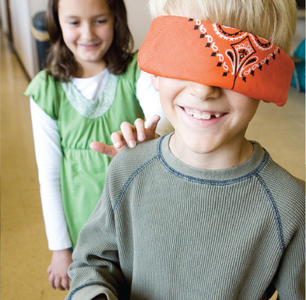
Social Integration Strategies
How to conduct a successful awareness activity in your classroom
Beware of Simulation
What are you trying to teach?
A Better Way
Inclusion in curriculum
A presentation promoting respect for visually impaired people and the skills and tools they use to accomplish tasks.
Have your V.I. student show his or her peers how they use assistive technology
Have a tactile experience
Kaila Sanford
Notes:
Information from : https://nfb.org/images/nfb/publications/fr/fr21/fr06ws09.htm
Photo Credit: http://childrensministry.com/wp-content/uploads/media/1968280/path.jpg, and http://henshaws.org.uk/wp-content/uploads/2014/05/Pathway.jpg
Slide 5: How to conduct a successful awareness activity in your classroom
As we’ve all been learning in all of our classes, it’s critically important to foster an open, accepting classroom environment. So even if you don’t have a visually impaired student in your class, it might be a good idea to teach your students how to be open and accepting of visually impaired people.
Teachers are often tempted to use simulation exercises to raise awareness and to show students “what it is like to be blind.” In these exercises, sighted students put on a blindfold and then attempt to perform various tasks or walk around the school building being guided by a classmate to “build trust.”
But what are the goals of exercises like these?
Sighted students will probably have trouble performing tasks under blindfold that they are accustomed to doing with their normal eyesight.
Is the goal to show them how hard it is to be blind?
Sighted students will probably be nervous giving over their safety to a guide who is walking them around.
Is the goal to show that blind people are helpless and dependent and must put their trust in good-hearted sighted people in order to get anywhere or to keep from falling down a flight of stairs?
Before you embark on such an activity, think about what you want the students to learn. Wearing a blindfold for a little while might show what it would be like to suddenly lose vision, but it absolutely does not show what it is like to be blind. Real blind/VI people learn a series of skills that enable them to perform tasks without or with very little eyesight. Likewise, real blind/VI people learn mobility skills so that they can trust themselves and get where they need to go.
If children are blindfolded but are not taught any of the skills that real visually Impaired people use, they are likely to emerge from a simulation experience feeling that blindness/visual impairment is scary, sad, and difficult.
Is this what you want them to think blindness/visual impairment is like? Instead of fostering acceptance, understanding, and respect, these exercises breed sadness, fear, and pity.
Instead of opening doors for seeing students to befriend Visually Impaired classmates, students can end up feeling distant, afraid of, and sorry for him or her.
So here’s a better way:
A better way to foster understanding and promote friendships is through a presentation that will promote respect for the VI student and inform students of the skills and tools he/she will be using.
Integrate Visually Impaired people into your curriculum.
Read the stories of Erik Weihenmayer, the blind man who successfully climbed Mt. Everest in 2001,
Or of Abraham Nemeth, the blind mathematician who created the Braille code for mathematics,
Or Geerat Vermeij, a blind biologist who is currently a professor at UC Davis
(these stories can be found on the National Federation of the Blind Web site, www.nfb.org)
Instead of blindfolding your students, give them some hands-on experiences with the tools and techniques of blindness/visual impairment. Here are some examples:
Your students might enjoy learning how to read and write a few simple words in Braille.
If you have a visually impaired student in your class, use them. If not, an adult presenter can write each student’s name in Braille on a piece of paper that the children can take home.
Point out that the number five on a phone pad usually has a tactile marking that blind/VI people use as a reference point when dialing; let students try to find the marking using their sense of touch. Then have your students locate the other numbers and try to dial their home phone number. This encourages students to be aware of little things in their lives that have significance they might not understand.
How many of you are on Mac computers? Look at your keyboard. Do you have markings on your keys? My macbook pro has tactile markers on the F and J keys. I never even noticed that until I was thinking of these activities for student awareness.
Brainstorm with the class about how people could accomplish various tasks without eyesight.
Activities like these teach empowerment to the visually impaired student, and teaches skills and broadens awareness for your normally sighted students.
Activities such as these will help students feel more empowered to interact with their blind/VI classmate.
These experiences help foster the idea that visually impaired classmates can be friends and equals,
Friendship and equality beat charity and pity any day

Slide 22
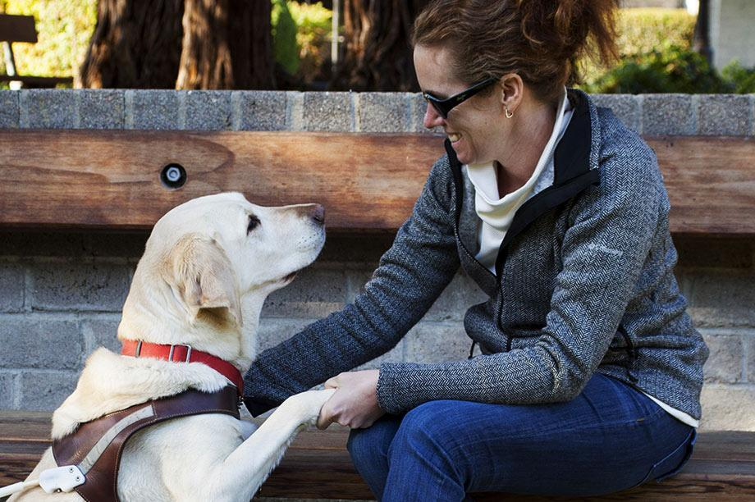
Guide Dogs!
Mission Statement
Guide Dogs for the Blind empowers lives by creating exceptional partnerships between people, dogs, and communities.
Vision Statement
Guide Dogs for the Blind envisions a world with greater inclusion, opportunity, and independence by optimizing the unique capabilities of people and dogs.
A dog in your classroom
Appropriate behavior
How to get involved
Field trips
Volunteer
Spread the word
Kaila Sanford
Notes:
Photo Credits:
Logo: welcome.guidedogs.com
Photo: http://www.guidedogs.com/images/content/pagebuilder/about-us-hero.jpg
Slide 7: Guide Dogs!
I’m really excited that I can pull one of my passions into this presentation.
Guide Dogs for the Blind is a wonderful national organization located right here in San Rafael. How many people here have seen trainers and volunteers out on the streets of downtown San Rafael?
GDFB breeds, trains, and matches dogs and humans in the US and Canada
All services are provided at no cost to the students — this includes the guide dog, transportation to and from the campus, instruction, lodging during the training program and more.
The dog-human matching and subsequent training classes are two weeks long. The classes generally have 6-8 students with a ratio of students to instructors of 2:1.
GDB provides graduates with a lifetime of support. They offer financial assistance for vet care, as needed; in-person follow up visits; access to a dedicated support center; and successor dogs, when its time for the guide dog to retire.
What to do when there’s a guide dog in the classroom.
Having a dog in the classroom can be distracting at first.
Part of having a dog be “on the job” is maintaining the differentiation between when they are working and when they are relaxing. If they have their harness on, they are working and shouldn’t be petted or given treats by anyone except for their human.
But kids have a hard time not petting the dog
Talk to your VI student about having them tell the class about their dog and giving the students one time to pet the dog early on in the school year. Then they’ll get it out of their system.
Your student has been through extensive training with their guide dog, so they know their dog’s needs best. If you are in a lower grade and have the same class all day, there may be a time in which the student should go outside for the dog to relieve itself. The general guideline is 4 or 5 times per day.
After being outside in rain or snow, A dog will need to be dried off, especially their paws. Give your student a minute or two (it shouldn’t take very long) of extra time at the classroom door.
How to get involved
The Guide Dogs volunteers love visitors and have free daily tours for school kids. It’s a great field-trip experience
Guide Dogs for the Blind has one of the largest volunteer bases in the US. It’s a nonprofit and it’s a great organization to be involved with.
It’s a fun place to volunteer.
If you have students who need community service hours, this is a good cause to support in that way.

Slide 23
Bonus: My Guide Dog
Kaila Sanford
Notes:
Slide 8: Cherry
I wanted to bring the guide dog that I take care of in to class today, but she had a lot of puppies in October and hasn’t fully regained her full strength.
To cheer you up after talking about impairments all evening, here’s a quick video clip of future guide dogs. This was taken about 2 weeks ago.

Slide 24
Helpful Resources
www.familyconnect.org
Website specifically for parents of children with visual impairments. Sponsored by the American Foundation for the Blind® and the National Association of Parents of Children with Visual Impairments
http://www.parentcenterhub.org/wp-content/uploads/repo_items/fs13.pdf
Disability Fact Sheet #13. Visual Impairments, including Blindness. A publication of NICHCY
http://www.afb.org/default.aspx
American Foundation for the Blind website. The American Foundation for the Blind removes barriers, creates solutions, and expands possibilities so people with vision loss can achieve their full potential.
http://www.teachingvisuallyimpaired.com/
Strategies for teaching students with visual impairments

